Slide 1

Session 06
Introduction to LINQ

Slide 2
Objectives
Define and describe Language Integrated Query (LINQ)
List and describe the commonly used query operators
Describe the use of LINQ to query different data sources

Slide 3
Introduction to LINQ
Windows Forms applications use ADO.NET for data handling
To overcome data handling issues, Microsoft introduced LINQ
LINQ queries data from diverse sources
These data sources must be LINQ-compatible
LINQ can be used with SQL, XML, Objects, ADO.NET DataSets, Entities, and so on

Slide 4
LINQ is supported by .NET 3.5 and C# 3.0
2002/2003 | 2005 | 2006 | 2008
Microsoft Visual Studio® 2002/2003 | Visual Studio 2005 | Visual Studio 2005 + Extensions | Visual Studio 2008
C# 1.0 | C# 2.0 | C# 2.0 | C# 3.0
.NET 1.0/1.1 | .NET 2.0 | .NET 3.0 | .NET 3.5
CLR 1.0 | CLR 2.0 | CLR 2.0 | CLR 2.0 SP1

Slide 5
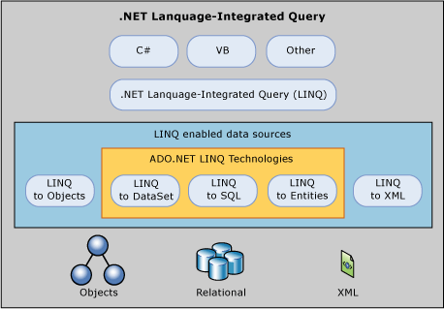
LINQ providers
A LINQ Provider is a gateway for LINQ to act upon data that is not inside a queryable type. LINQ providers can give LINQ access to data inside SQL Server, inside XML, and more. Microsoft currently ships the 5 LINQ technologies shown in the diagram below

Slide 6
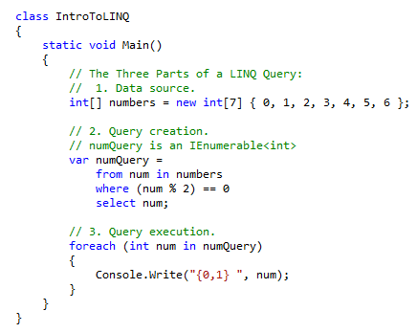
The Parts of a Query Operation
All LINQ query operations consist of three distinct actions
Obtain the data source
Create the query.
Execute the query

Slide 7
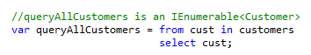
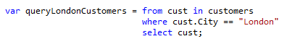
Basic LINQ Query Operations
In a LINQ query, the first step is to specify the data source.
Filtering
AND, OR Operators

Slide 8
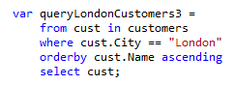
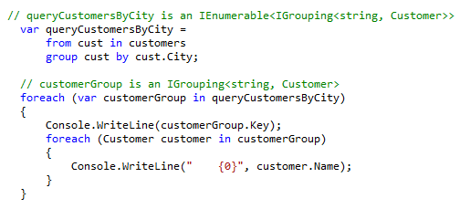
Basic LINQ Query Operations…
Ordering
Grouping

Slide 9
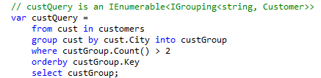
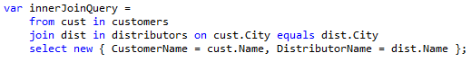
Basic LINQ Query Operations…
Grouping
Joining

Slide 10
LINQ to Objects
Enables you to write queries over any enumerable collection, such as arrays, lists, and collection
Queries any collection that implements interfaces, IEnumerable, IQueryable, or IEnumerable(Of T)
LINQ queries are better than foreach loops when querying in-memory collections and objects

Slide 11
LINQ to Objects – Example
The example demonstrates a LINQ to Objects query.
private void frmEmployee_Load(object sender, EventArgs e)
{
ArrayList arrList = new ArrayList();
arrList.Add(
new Employee
{
FirstName = "Lara",
LastName = "Baker",
Salary = 2000,
Location = "New Jersey"
});
arrList.Add(
new Employee
{
FirstName = "Mark",
LastName = "Dell",
Salary = 3900,
Location = "New Jersey"
});
arrList.Add(
new Employee
{
FirstName = "Steven",
LastName = "James",
Salary = 2500,
Location = "California"
});
var query = from Employee emp in arrList
where emp.Location == "New Jersey"
select emp;
foreach (var employee in query)
{
lstEmp.Items.Add(employee.FirstName + " " + employee.LastName);
}
}
}
Snippet
public class Employee
{
public string FirstName { get; set; }
public string LastName { get; set; }
public string Location { get; set; }
public int Salary { get; set; }
}
public partial class frmEmployee : Form
{
public frmEmployee()
{
InitializeComponent();
}

Slide 12
LINQ to XML
Creates, stores, and retrieves XML data
Important classes of LINQ to XML are XDocument, XElement, and XAttribute
These classes are defined in System.Xml.Linq namespace

Slide 13
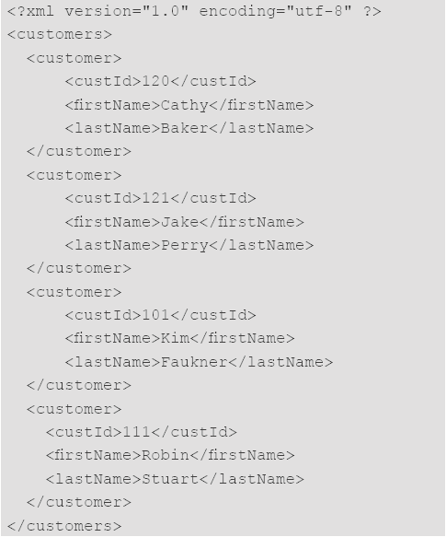
LINQ to XML – Example 1-6
Create a new Windows Forms application named CustomerData.
Add an XML file to the project and name it Customers.xml. Add the following content to it:

Slide 14
LINQ to XML – Example 2-6
Save and close the XML file.
Right click on Customers.xml in the Solution Explorer and select Properties. Set the Copy To Output Directory property to Copy if newer.
Set the Name and Text properties for the form to frmCustomers and Customer Data respectively.
Add a ListBox to the form and set the Name property to lstCustomers.
Add a Button to the form and set the Name and Text properties to btnLoad and Load Customers respectively.
Add a Button to the form and set the Name and Text properties to btnGet and Get Customer Info respectively.
Add two TextBox controls to the form and set their Name properties to txtFirstname and txtLastname respectively.
Add a Label above the text box, txtFirstname, and set its Name and Text properties to lblFirstname and First Name respectively.
Add a Label above the text box, txtLastname, and set its Name and Text properties to lblLastname and Last Name respectively.

Slide 15
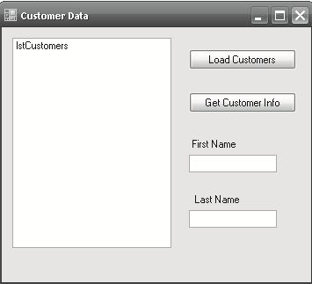
LINQ to XML – Example 3-6
Arrange the controls in the form as shown in the figure.

Slide 16
LINQ to XML – Example 4-6
Double-click the Load Customers button. This will generate an event handler and automatically switch to code view.
Add a using statement for the System.Xml.Linq namespace in the using section of the code.
Add the following code in the event handler to load the customers list from the XML file:
Snippet
private void btnLoad_Click(object sender, EventArgs e)
{
// If already populated earlier, clear the list
lstCustomers.Items.Clear();
XElement root = XElement.Load("Customers.xml");
IEnumerable<XElement> customer = from el in root.Descendants("customer")
orderby
el.Element("custId").Value
select el;
foreach (XElement el in customer)
{
lstCustomers.Items.Add(el.Element("custId").Value);
}
}

Slide 17
LINQ to XML – Example 5-6
Double-click the Get Customer Info button to generate an event handler.
Add the following code to load the customer details from the XML file:
Snippet
private void btnGet_Click(object sender, EventArgs e)
{
XElement root = XElement.Load("Customers.xml");
IEnumerable<XElement> product =
from el in root.Descendants("customer")
where (el.Element("custId").Value ==
lstCustomers.SelectedItem.ToString())
select el;
foreach (XElement el in product)
{
txtFirstname.Text = el.Element("firstName").Value;
txtLastname.Text = el.Element("lastName").Value;
}
}

Slide 18
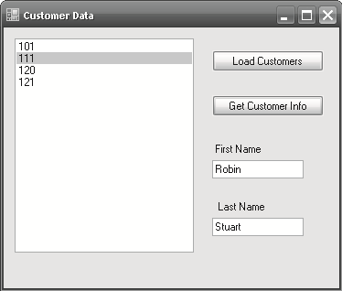
LINQ to XML – Example 6-6
Build and execute the application.
Click the Load Customers button. This populates all the customer ids in the list box. Select a customer id in the list. Click the Get Customer Info button.
Output

Slide 19
LINQ to DataSet
Enables you to write queries from within C# applications, instead of using a separate query language
LINQ capabilities can be used with DataSet to construct complex queries
LINQ support for DataSet is implemented entirely in System.Data.Extensions.dll
A DataSet must be populated with data before LINQ queries can be performed on it

Slide 20
LINQ to DataSet – Example
Populating the DataSet and constructing a LINQ to DataSet query
Snippet
MovieDataSet dataSet = new MovieDataSet();
MovieDataSetTableAdapters.MoviesTableAdapter mta = new
MovieDataSetTableAdapters.MoviesTableAdapter();
mta.Fill(dataSet.Movies);
var movie = from Movie in dataSet.Movies
select new
{
MovieId = Movie.MovieID,
MovieTitle = Movie.MovieName,
Category = Movie.Category
};
foreach (var row in movie)
{
MessageBox.Show(row.MovieId.ToString(),"", MessageBoxButtons.OK,
MessageBoxIcon.Information);
MessageBox.Show(row.MovieTitle.ToString(),"", MessageBoxButtons.OK, MessageBoxIcon.Information);
MessageBox.Show(row.Category.ToString(),(),"", MessageBoxButtons.OK,MessageBoxIcon.Information);
}

Slide 21
LINQ to SQL 1-6
Queries and manipulates data from SQL Server databases
Requires a reference to System.Data.Linq namespace
Maps the data object model using Table and Column attributes
DataContext object contains the information to connect to the database
DataContext converts the requests for objects into SQL queries against the database and then converts the results into objects

Slide 22
LINQ to SQL 2-6
Steps to query a table using LINQ to SQL
Create a new Windows Forms application named MovieApplication. Set the Name and Text properties of the default form to frmLinqToSql and LINQ to SQL respectively
Select Project → Add Reference and add a reference to System.Data.Linq.dll
Add using statements for System.Data.Linq and System.Data.Linq.Mapping to the form. These namespaces are required to implement the LINQ to SQL functionality
Add a ComboBox to the form and set its Name property to cboCategory
Add a DataGridView to the form and set its Name property to dgvwMovies
Add a Button to the form and set its Name and Text properties to btnSave and Save respectively

Slide 23
LINQ to SQL 3-6
private string _MovieName;
[Column(Storage = "_MovieName")]
public string MovieName
{
get
{
return this._MovieName;
}
set
{
this._MovieName = value;
}
}
private string _Category;
[Column(Storage = "_Category")]
public string Category
{
get
{
return this._Category;
}
set
{
this._Category = value;
}
}
}
Add the following code:
Snippet
[Table(Name = "Movies")]
public class Movies
{
private int _MovieID;
[Column(IsPrimaryKey = true, Storage = "_MovieID")]
public int MovieID
{
get
{
return this._MovieID;
}
set
{
this._MovieID = value;
}
}

Slide 24
LINQ to SQL 4-6
Add the following code at class level of frmLinqToSql to create the DataContext and a table against which you want to query.
Snippet
private void frmLinqToSql_Load(object sender, EventArgs e)
{
// Get a typed table to run queries
Movies = dcontext.GetTable<Movies>();
// Retrieve a list of Categories using a LINQ to SQL query
var query = from movie in Movies
select movie.Category;
// Populate the categories into the combo box
foreach (var category in query.Distinct())
{
cboCategory.Items.Add(category.ToString());
}
// Set the default selection
cboCategory.SelectedIndex = 0;
}
Snippet
DataContext dcontext = new DataContext("Data Source = pop\\express; Initial Catalog=MovieDB; uid=sa; pwd=release; Integrated Security =True");
Table<Movies> Movies;
Create an event handler for Load event of the form and add the following code to query the Movies table.

Slide 25
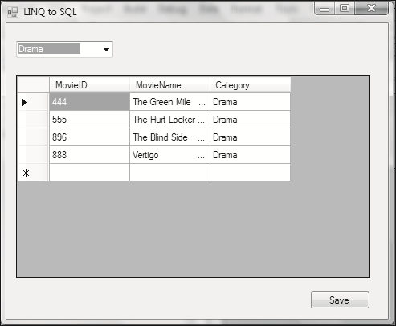
LINQ to SQL 5-6
Create an event handler for the SelectedIndexChanged event of cboCategory and add the following code:
Output
Snippet
private void cboCategory_SelectedIndexChanged(object sender, EventArgs e)
{
string selected = cboCategory.SelectedItem.ToString().Trim();
// Retrieve data using a LINQ to SQL query
var movies = from movie in Movies
where movie.category == selected
select movie;
dgvwMovies.DataSource = movies;
}

Slide 26
LINQ to SQL 6-6
Add the following code to the Click event of the Save button.
Snippet
private void btnSave_Click(object sender, EventArgs e)
{
try
{
dcontext.SubmitChanges();
MessageBox.Show("Record Added");
}
catch (Exception ex)
{
MessageBox.Show(ex.Message);
}
}

Slide 27
Summary and Workshop 1
LINQ is a set of technologies introduced in Visual Studio 2008 that simplifies data access in various formats from different data sources.
A query expression is a query that is written in query syntax and is used to query and transform data from a LINQ-compatible data source.
Standard query operators represent the operations available in LINQ and are used for tasks such as filtering, counting, aggregating, sorting, and so forth.

Slide 28
Summary and Workshop 2
LINQ can be categorized into following flavors: LINQ to SQL, LINQ to XML, LINQ to Objects, and LINQ to DataSets.

Slide 29

THANKS FOR WATCHING !

